Slide 1
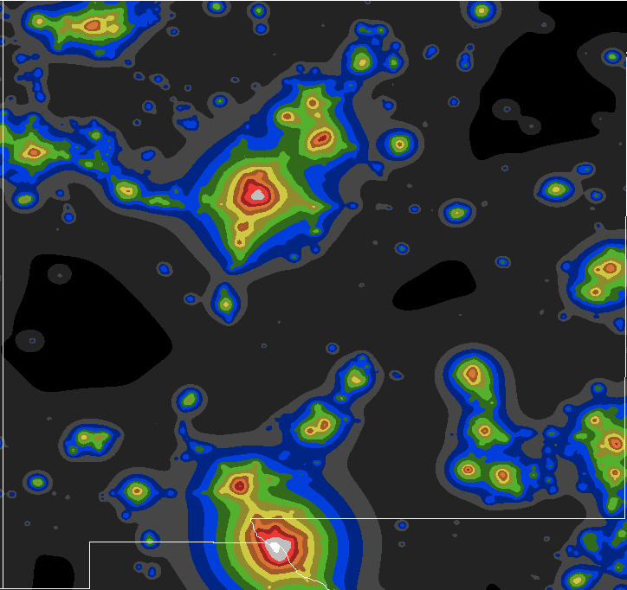
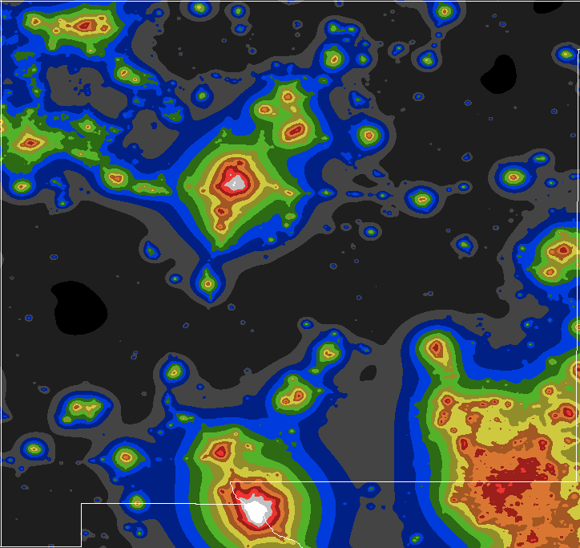
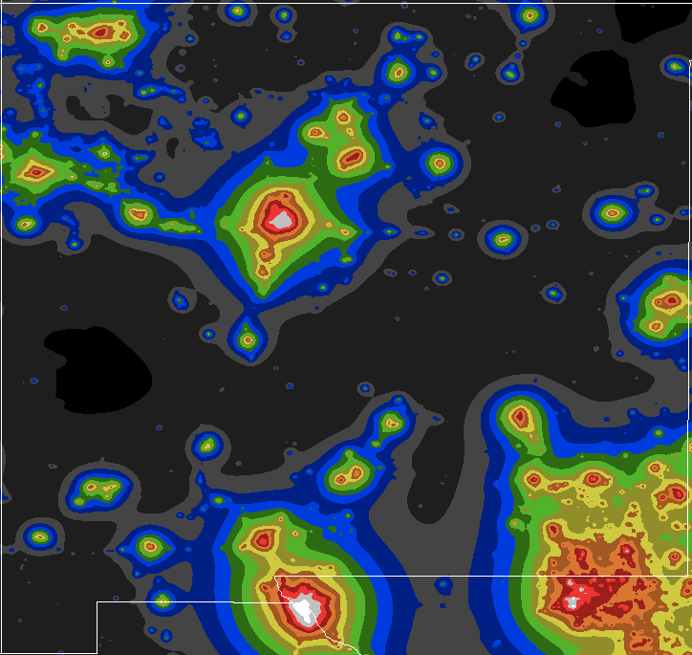
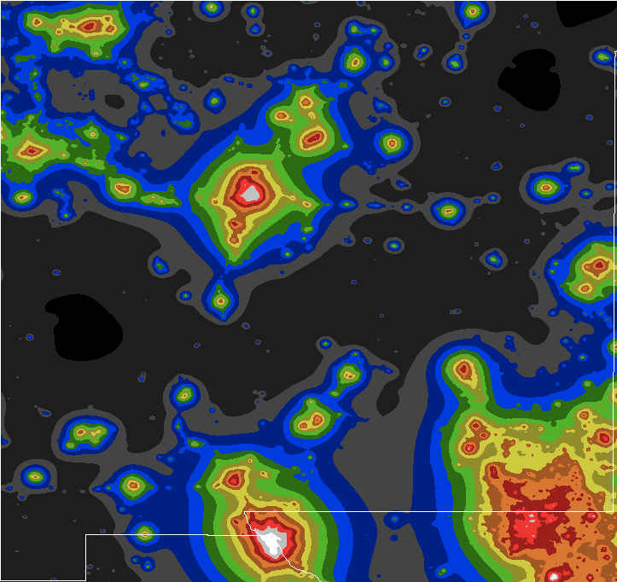
2006, 2016,2020, 2022 light pollution
https://djlorenz.github.io/astronomy

Slide 2
2006 light pollution
2022 Light pollution
https://djlorenz.github.io/astronomy

Slide 3
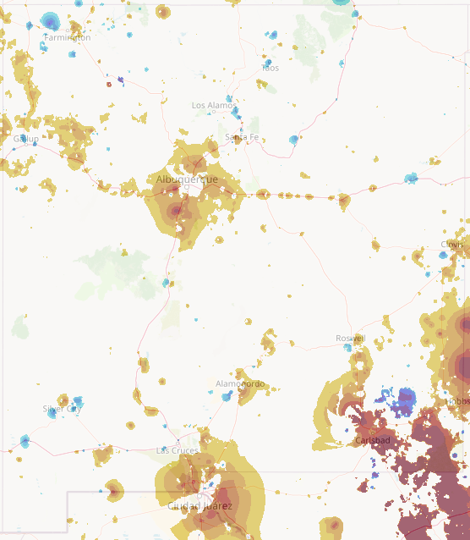
Change in light pollution from 2013-2022
Browns show increasing light pollution
From https://djlorenz.github.io/astronomy/lp2006/overlay/dark.html

Slide 4
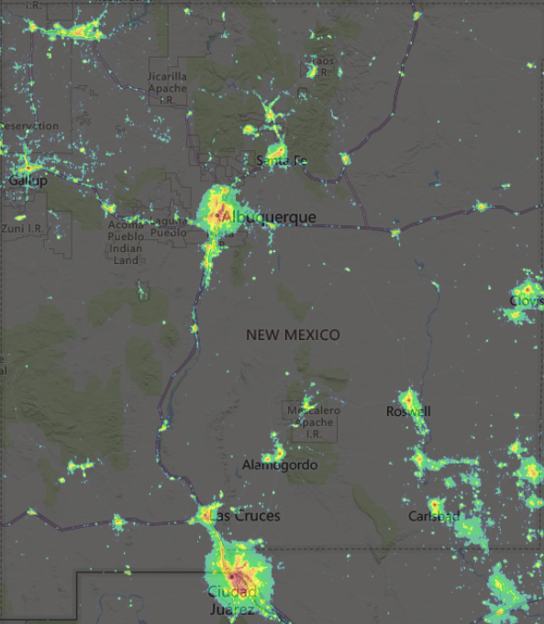
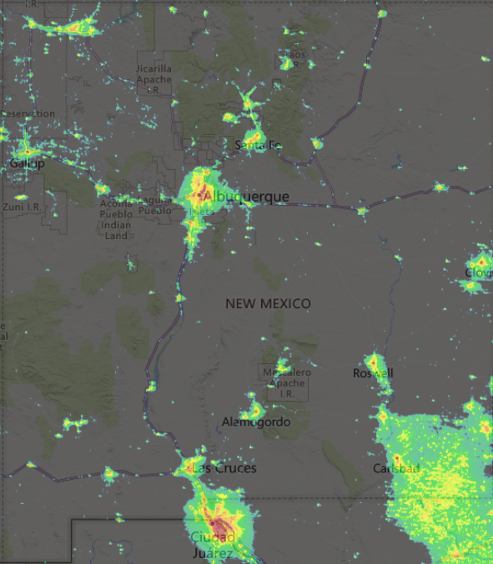
VIIRS 2012
VIIRS 2023
From lightpollutionmap.info

Slide 5
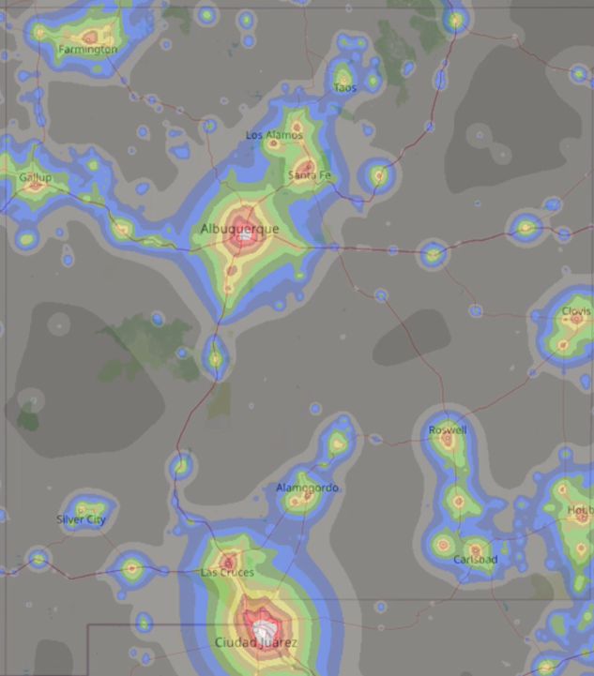
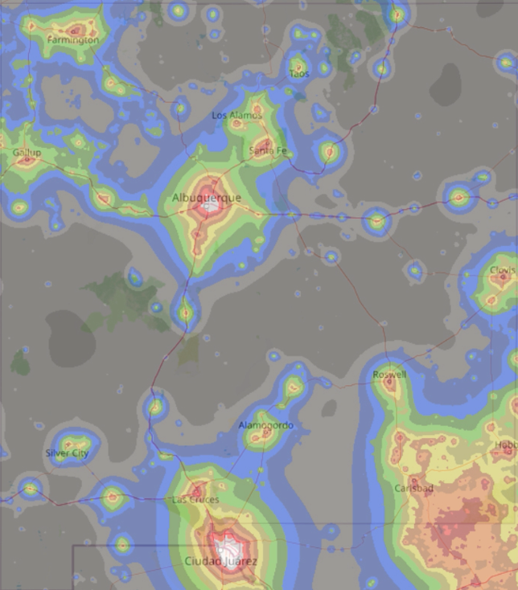
2006 light pollution
2022 light pollution

